Slide 1
Renewable Energy Generation Forecasting
(AIS21)
Hassaan Shah
Nitish Kumar
Yashwanth Rawat
Sunil Chudasuma

Slide 2


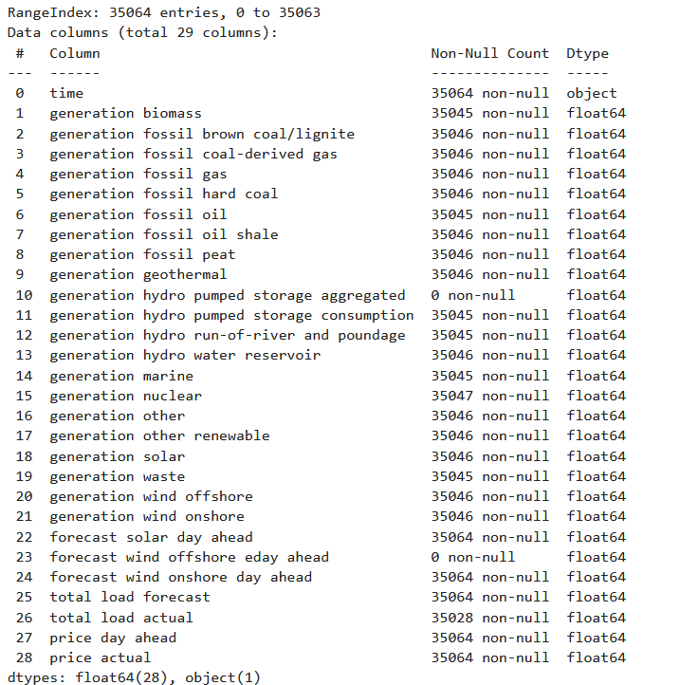
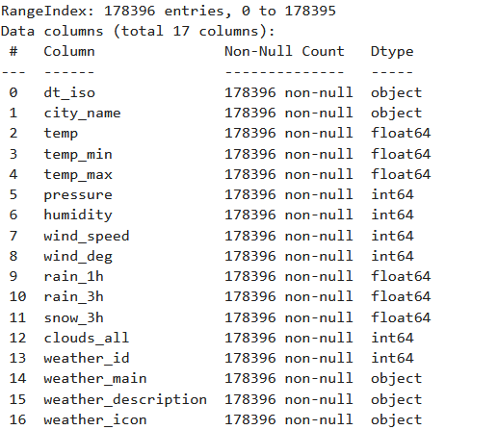
energy_dataset Info
weather_features Info

Slide 3
Data Preprocessing & Feature Engineering

Slide 4
Engineering the Forecasting Dataset
Targeted Feature Selection: Dropped irrelevant fossil fuel, hydro, and pricing columns to focus exclusively on solar generation and total load variables.
Weather Data Cleanup: Eliminated redundant metrics (e.g., weather icons, min/max temperatures) and removed duplicate city-time records.
City-Level Pivoting: Restructured the weather dataset so each city's specific conditions (e.g., Barcelona_temp, Valencia_humidity) serve as distinct, localized features.
Time-Series Alignment: Standardized timestamps to UTC and merged the grid energy data with the localized weather features into a single, unified dataframe for the forecasting model.

Slide 5

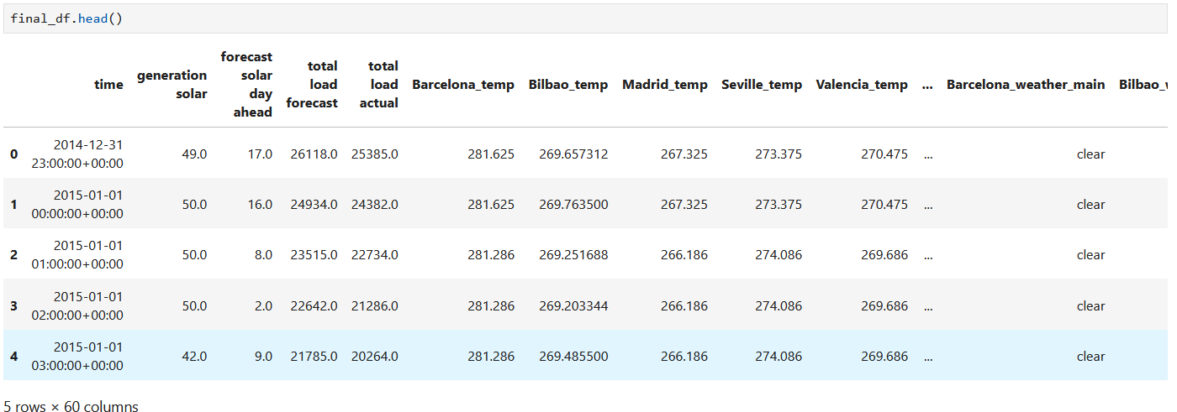
Final Dataset

Slide 6
Distributing data into Categorical & numerical columns
Target Column = ‘Solar Generation’

Slide 7
Outlier Treatment

Slide 8
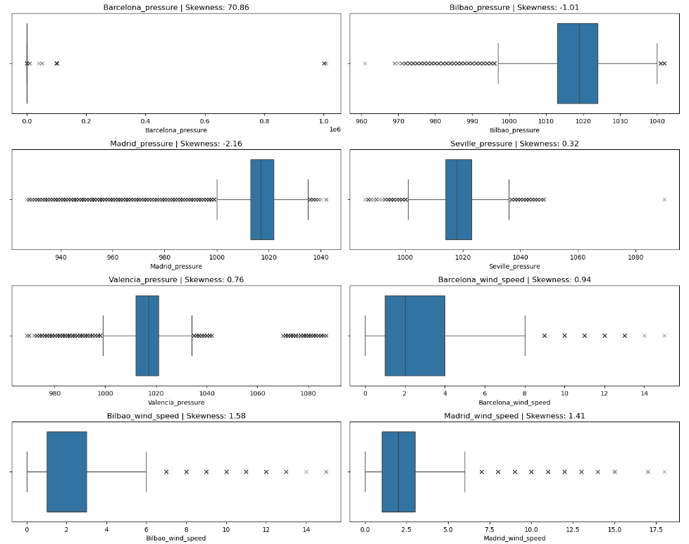
Noticed extreme outliers in the data

Slide 9
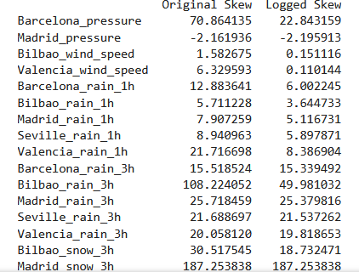
Method 1 (Converting into logs)

Slide 10
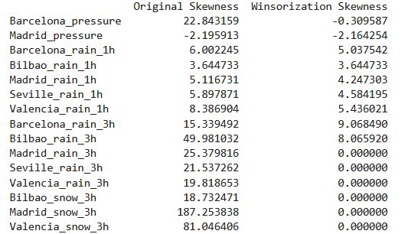
Method 2 (winsorization skewness)

Slide 11
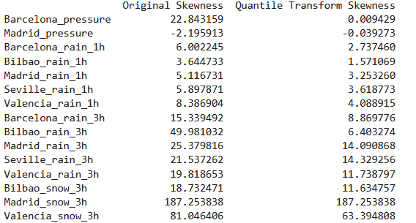
Method 3 (Quantile Transformation)
Opted this method of outlier transformation

Slide 12
Data Visualization

Slide 13
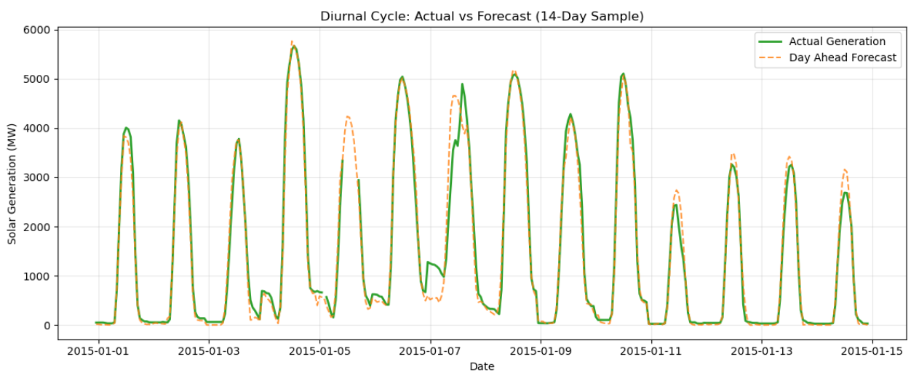
It visually tracks actual solar generation against the grid operator's predictions over a 14-day period.
It highlights massive, unpredicted intra-day generation crashes (specifically around January 7th) where the forecast completely failed.

Slide 14
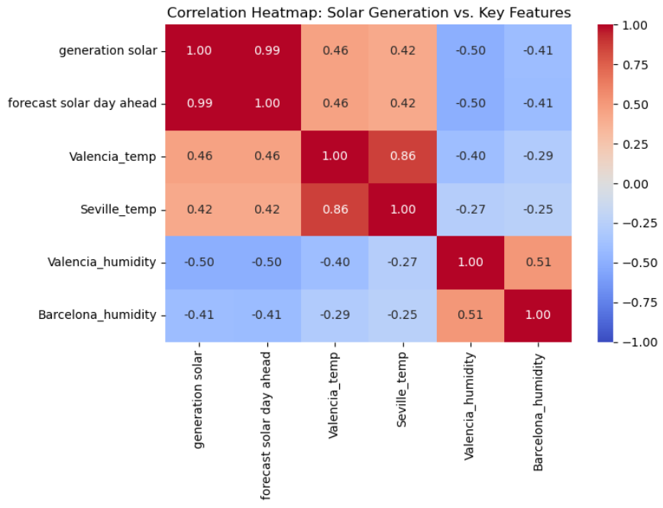
The forecast solar day ahead is nearly perfectly correlated (0.99) with actual generation, confirming it as the primary mathematical anchor for the predictions.

Slide 15
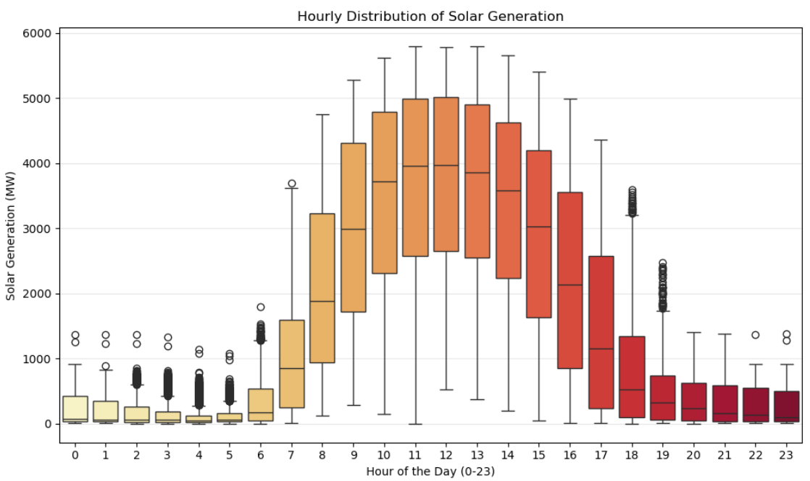
Distributed timeseries data on an hourly basis
Most energy is produced during Hour 8 to Hour 17 (9 hours)

Slide 16
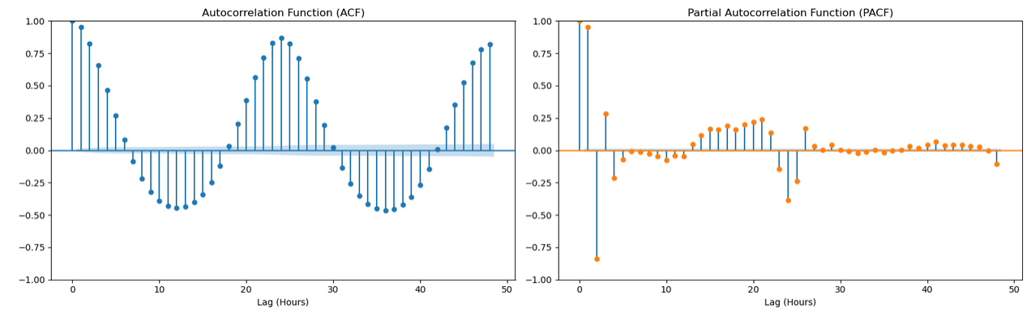
This visualization represents Autocorrelation Function (ACF) and Partial Autocorrelation Function (PACF) plots for the generation solar variable over a 48-hour period. These graphs statistically measure how strongly current solar energy generation correlates with past hourly generation data.
The ACF plot on the left exhibits a continuous sine-wave pattern with major positive peaks at exactly 24 and 48 hours. This mathematically visualizes the repeating daily cycle of the sun.3) The PACF plot on the right isolates the direct relationship of specific past hours without the trailing momentum of intermediate hours. The massive spikes at Lag 1 and Lag 2 indicate that the generation output from one and two hours prior are dominant predictive signals.

Slide 17
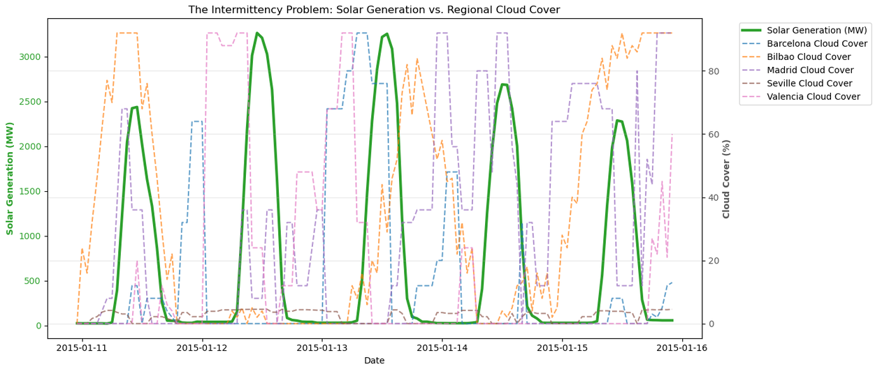
The provided graph, titled "The Intermittency Problem: Solar Generation vs. Regional Cloud Cover," is a dual-axis time-series plot that tracks actual solar energy production against the cloud cover percentages of five cities over a five-day period in January 2015.
The jagged, erratic movements of the regional cloud cover lines illustrate exactly why solar generation is difficult to predict with a static baseline. A sudden localized cloud front can rapidly alter the national generation total, visually proving to the judges why your machine learning model must rely on regional weather features to capture these intra-day grid fluctuations.

Slide 18
Data Encoding & Train/Test Split

Slide 19
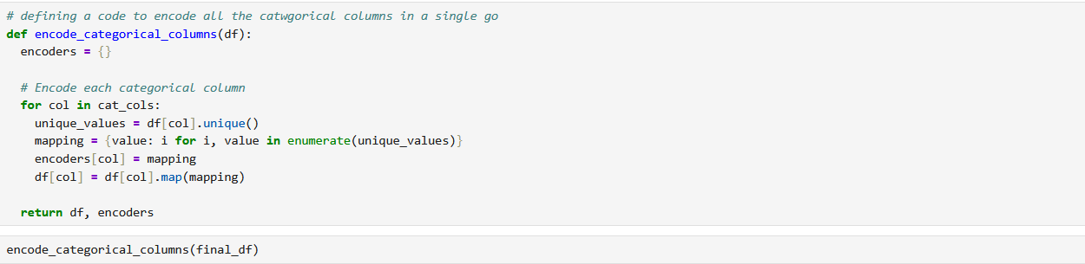
Data Encoding

Slide 20
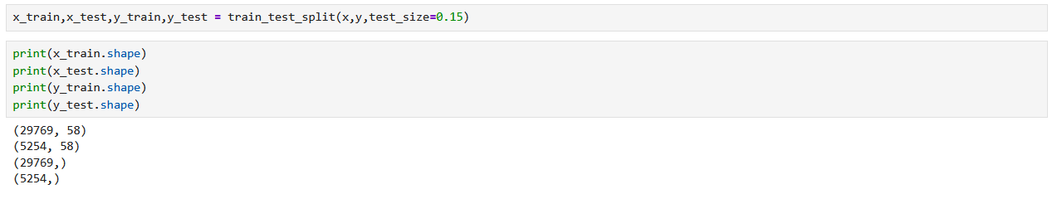
Train/Test Split

Slide 21
Model Fitting

Slide 22

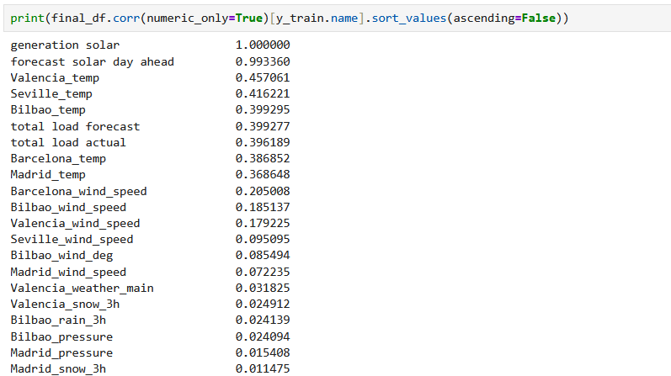
Linear Regression

Slide 23
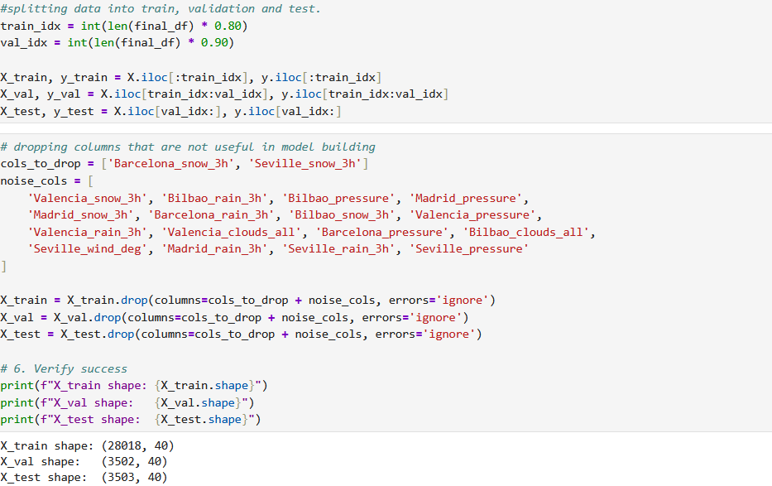
Data Optimization

Slide 24
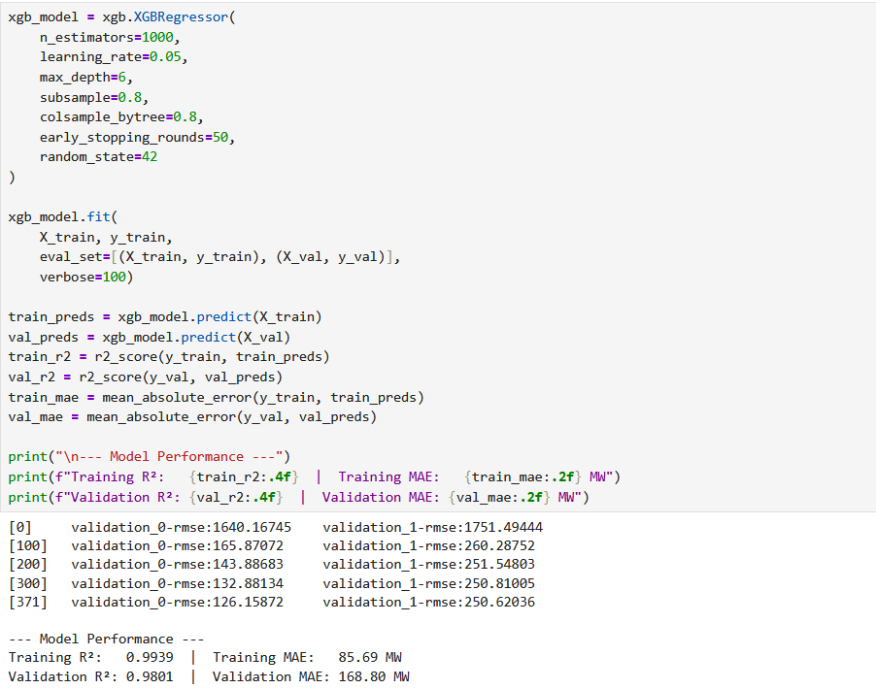
XGBoost

Slide 25
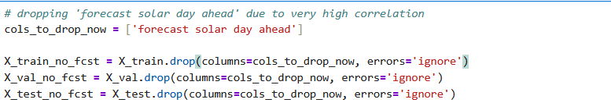
Removing ‘forecast solar day ahead’

Slide 26
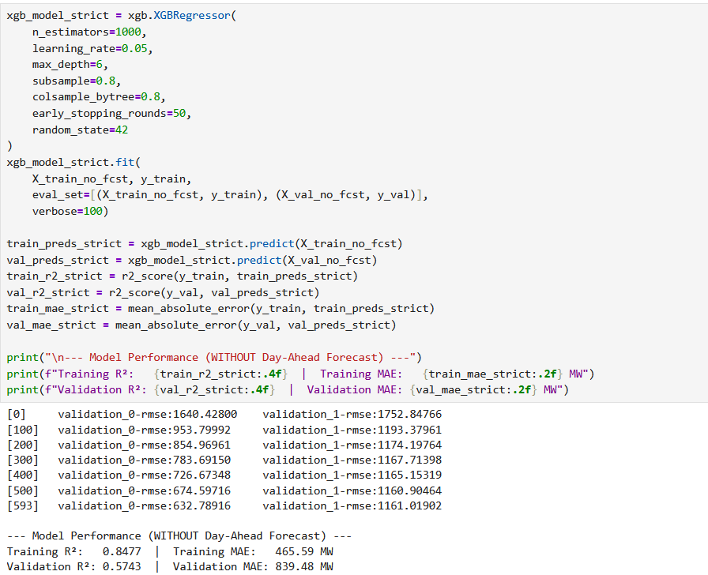
Modified XGBoost

Slide 27
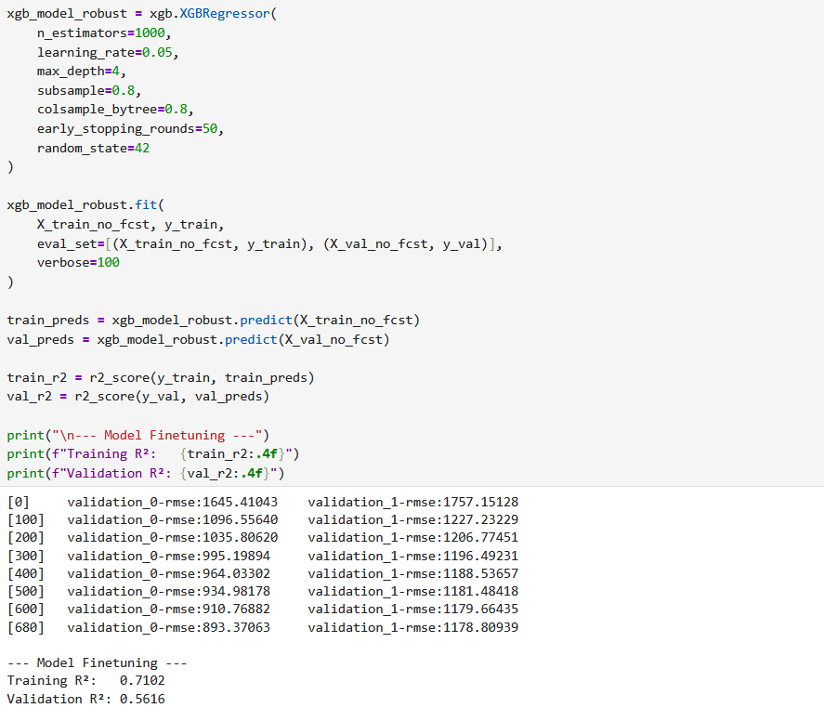
XGBoost (Fine Tuning)

Slide 28
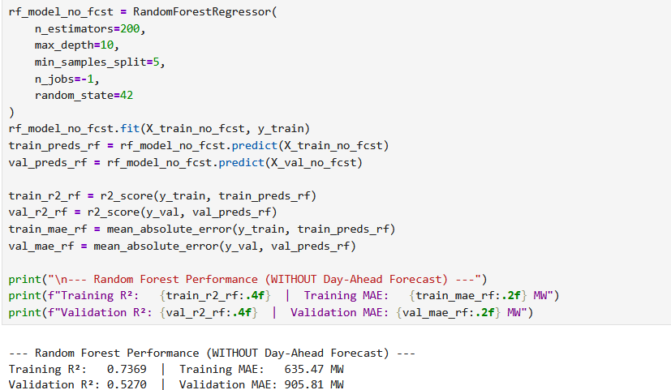
Random Forest Regressor

Slide 29
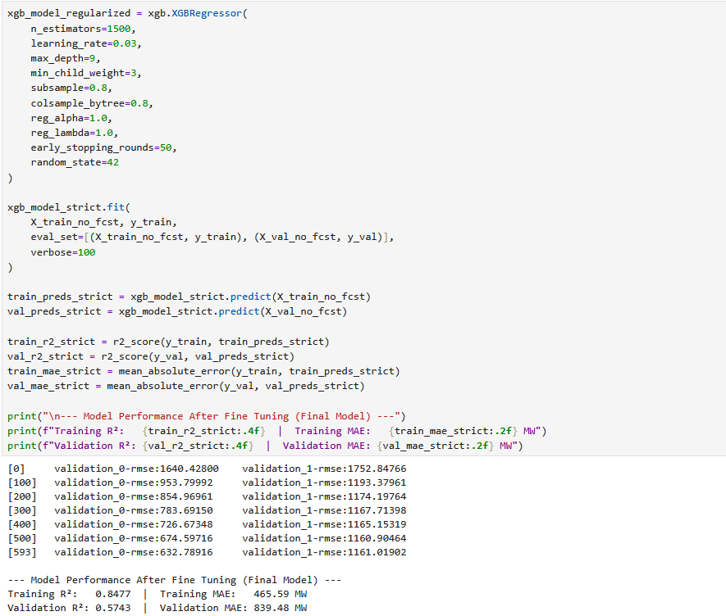
Final Model

Slide 30
Conclusion
Stabilizing the Grid: Fusing localized meteorological data with historical NREL solar output directly predicts short-term generation drops, neutralizing the grid's reliance on backup fossil-fuel peaker plants.
Measurable Sustainability: Our forecasting pipeline minimizes grid curtailment waste, directly advancing UN SDGs 7 (Clean Energy), 9 (Innovation), 12 (Responsible Consumption), and 13 (Climate Action).
Scalable Architecture: Built on robust, tree-based and time-series modeling, the data pipeline is designed to seamlessly integrate live satellite cloud-imagery and scale across diverse geographic grid networks.

